Slide 1
DB
JOINS

Slide 2
Database content
ENTITY - ERD
1
C1 ERD DESIGN
RELATIONSHIPS
NORMALISATION
DB
CREATE TABLE
2
C2 SQL BASIC
INSERT & UPDATE
WHERE
3
C2 SQL SELECT
GROUP BY
JOIN
4
C2 SQL JOIN & VIEWS
VIEW

Slide 3

OBJECTIVES FOR TODAY
JOINS :
INNER
LEFT JOIN
RIGHT JOIN
OUTER

Slide 4

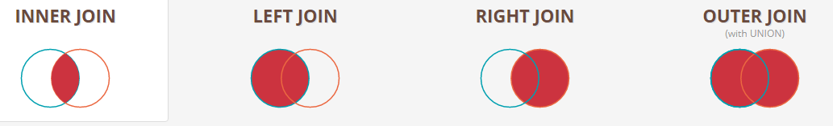
EXPLANATION
15 min
Go to:
https://joins.spathon.com/
Teacher explains the 4 JOINS using the 2 tables (User & Likes)
Notes:
SELECT teacher.firstname, subject.title FROM teacher JOIN subject ON teacher.teacherID = subject.teacherID;

Slide 5
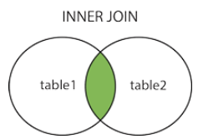
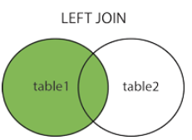
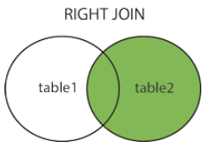
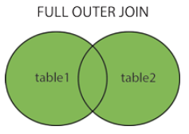
INNER JOIN:
Returns records that have matching values in both tables
LEFT JOIN:
Returns all records from the left table, and the matched records from the right table
RIGHT JOIN
Returns all records from the right table, and the matched records from the left table
OUTER JOIN
Returns all records when there is a match in either left or right table

Slide 6
EXERCICE-1
5 min
Insert the missing parts in the JOIN clause to join the two tables Orders and Customers, using the customerID field in both tables as the relationship between the two tables.
SELECT *
FROM Orders
LEFT JOIN Customers
=
;

Slide 7
EXERCICE-1
5 min
Insert the missing parts in the JOIN clause to join the two tables Orders and Customers, using the customerID field in both tables as the relationship between the two tables.
SELECT *
FROM Orders
LEFT JOIN Customers
=
;
ON Order.customerId
Customers.customerId

Slide 8
EXERCICE-2
5 min
Choose the correct JOIN clause to select all records from the two tables where there is a match in both tables.
SELECT *
FROM Orders
ON Orders.CustomerID=Customers.CustomerID;

Slide 9
EXERCICE-2
5 min
Choose the correct JOIN clause to select all records from the two tables where there is a match in both tables.
SELECT *
FROM Orders
ON Orders.CustomerID=Customers.CustomerID;
INNER JOIN Customers

Slide 10
EXERCICE-3
5 min
Choose the correct JOIN clause to select :
all the records from the Customers table
plus all the matches in the Orders table.
SELECT *
FROM Orders
ON Orders.CustomerID=Customers.CustomerID;

Slide 11
EXERCICE-3
5 min
Choose the correct JOIN clause to select :
all the records from the Customers table
plus all the matches in the Orders table.
SELECT *
FROM Orders
ON Orders.CustomerID=Customers.CustomerID;
Right join customers

Slide 12
How many rows are display in the bellow querry ?
Product
Category
pID pName catID
Fridge 1
Rice cooker 1
3 Dell Thinpad 2
4 Acer Core i7 2
5 Bike null
catID catName
Kitchen
Computer
Garden
SELECT * FROM Product LEFT JOIN Categories ON Product.pID = Category.catID;
A
3
B
4
C
5
D
6

Slide 13
How many rows are display in the bellow querry ?
Product
Category
pID pName catID
Fridge 1
Rice cooker 1
3 Dell Thinpad 2
4 Acer Core i7 2
5 Bike null
catID catName
Kitchen
Computer
Garden
SELECT * FROM Product LEFT JOIN Categories ON Product.catID = Category.catID;
A
3
B
4
C
5
D
6

Slide 14
How many rows are display in the bellow querry ?
Product
Category
pID pName catID
Fridge 1
Rice cooker 1
3 Dell Thinpad 2
4 Acer Core i7 2
5 Bike null
catID catName
Kitchen
Computer
Garden
SELECT * FROM Product OUTER JOIN Categories ON Product.catID = Category.catID;
A
3
B
4
C
5
D
6

Slide 15
How many rows are display in the bellow querry ?
Product
Category
pID pName catID
Fridge 1
Rice cooker 1
3 Dell Thinpad 2
4 Acer Core i7 2
5 Bike null
catID catName
Kitchen
Computer
Garden
SELECT * FROM Product OUTER JOIN Categories ON Product.pID = Category.catID;
A
3
B
4
C
5
D
6

Slide 16
Expected result
Product
Categories
pID pName catID
Fujisu LCD Monitor 1
Dell LCD Monitor 1
3 Dell Thinpad 2
4 Acer Core i7 2
5 HP Desktop Null
catID catName
Monitor
Laptop
Desktop
What is the different between those 2 queries
SELECT * FROM Product p, Categories c WHERE p.catID = c.catID;
Q1
SELECT * FROM Product p INNER JOIN Categories c ON p.catID = c.catID;
Q2
A
B
C
D
No the same result
Same result
but Q1 is faster
Same result
but Q2 is faster
Exactly
the same

Slide 17
Expected result
Product
Categories
pID pName catID
Fujisu LCD Monitor 1
Dell LCD Monitor 1
3 Dell Thinpad 2
4 Acer Core i7 2
5 HP Desktop Null
catID catName
Monitor
Laptop
Desktop
What is the different between those 2 queries
SELECT * FROM Product p, Categories c WHERE p.catID = c.catID;
Q1
SELECT * FROM Product p INNER JOIN Categories c ON p.catID = c.catID;
Q2
A
B
C
D
No the same result
Same result
but Q1 is faster
Same result
but Q2 is faster
Exactly
the same

Slide 18
INNER JOIN OR WHERE ?
An INNER JOIN is equivalent to a WHERE
BUT
With a INNER JOIN , we clearly know 2 tables are joined

Slide 19
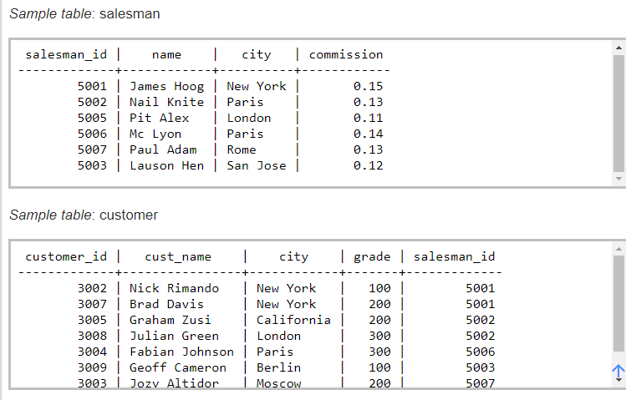
Write a SQL statement to prepare a list with salesman name, customer name and their cities for the salesmen and customer who belongs to the same city.
5 min
USING WHERE

Slide 20
Write a SQL statement to prepare a list with salesman name, customer name and their cities for the salesmen and customer who belongs to the same city.
5 min
USING WHERE
SELECT salesman.name customer.cust_name, customer.city
FROM Salesman,Customer
WHERE
salesman.city=customer.city;

Slide 21
Write a SQL statement to prepare a list with salesman name, customer name and their cities for the salesmen and customer who belongs to the same city.
5 min
USING INNER

Slide 22
Write a SQL statement to prepare a list with salesman name, customer name and their cities for the salesmen and customer who belongs to the same city.
5 min
USING INNER
SELECT salesman.name customer.cust_name, customer.city
FROM Salesman
JOIN Customer
ON
Salesman.city=Customer.city;

Slide 23
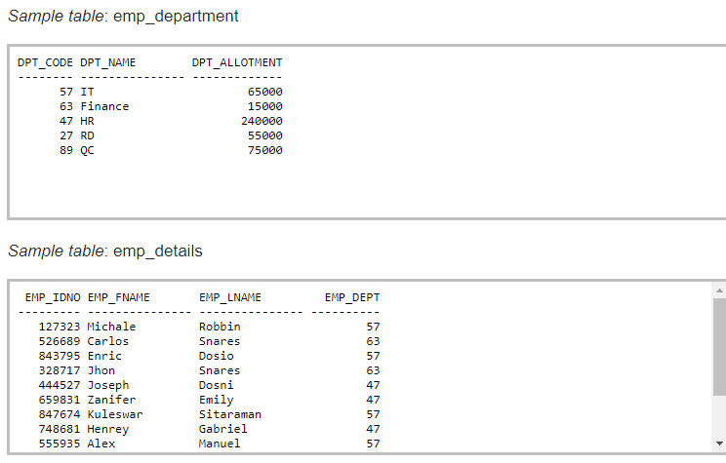
Write a query in SQL to display all the data of employees including their department
5 min

